Slide 1


Kick Starter Data Analysis Project
By : Group-3
Members are :
Manan , Manish , Muhammed , Jashwanth , Deepthi , Sanket , Uday

Slide 2
Contents
Project Overview & Objective
1
2
Data Cleaning and Modeling
Dashboard Presentation
3
4
Challenges Faced
Scope of Improvement and conclusion
5

Slide 3
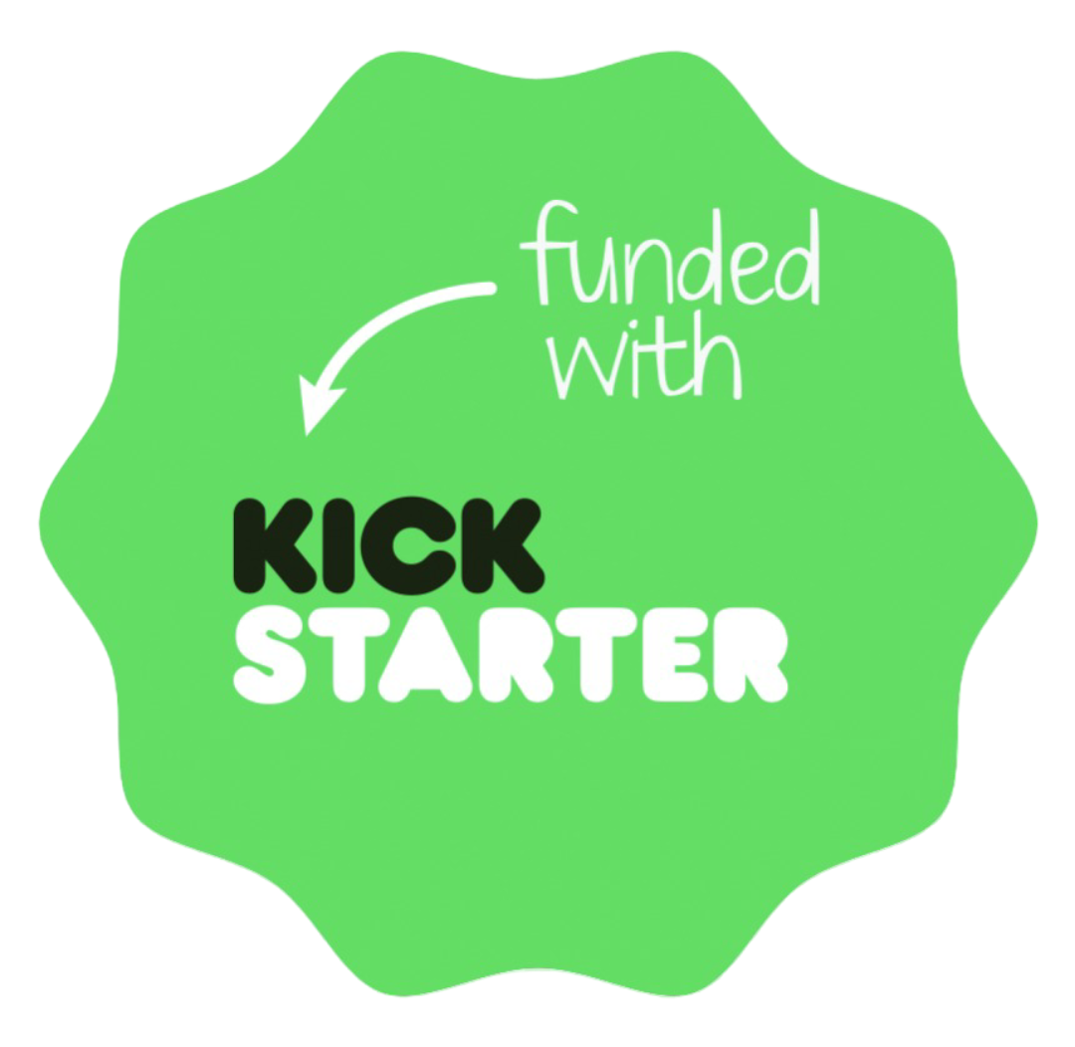
Project Overview & Objective
Project Overview
Kickstarter is a global crowdfunding platform supporting creative projects.
Covers categories like technology, film, music, art, design, and publishing.
Creators set funding goals; backers pledge money to bring ideas to life.
Follows an all-or-nothing funding model — money is collected only if the goal is met.
Kickstarter charges a 5% commission fee on successfully funded projects, plus payment processing fees (3–5%).
Team & Timeline
7-member team with distributed task assignments.
4-week project duration, evolving through various tools:
Week 1: Excel for initial data exploration.
Week 2: Power BI for initial modeling and visualization.
Week 3: Tableau and SQL for advanced analysis.
Week 4: Final presentation preparation.
Key Goal: Ensure consistent Key Performance Indicators (KPIs) across all analytical tools used.

Slide 4




Data Cleaning And Data Modeling
Distributed Cleaning
Rigorous Cleaning
Each team member was responsible for cleaning and modeling one specific dataset, ensuring thorough initial processing.
Systematic removal of duplicates and comprehensive handling of missing values across all datasets to maintain data integrity.
Seamless Integration
Standardized KPIs
All individual sheets were meticulously merged into a single, cohesive master dataset, ready for unified analysis.
Implemented a unified set of KPIs, ensuring consistency and comparability across Power BI, Tableau, and SQL environments.
This structured approach to data preparation was crucial for building a reliable foundation for our subsequent analysis and dashboard development.

Slide 5
KPI List
Number of Projects: 365.89K (Total projects in the dataset)
Total Goals: 18.38bn (Total funding amount creators set as their goal)
Total Amount Raised: 3.86bn (Total funding amount pledged by backers)
Success Percentage: 38.35% (Overall success rate of projects)
Number of Backers: 44.52M (Total number of individual backers)
Avg No. of Days for successful projects: 80.43 (Average duration of successful campaigns)
Kickstarter Commission Rate: 5%
Commission Received=Total Amount Raised×5%
Commission Received=$3.86 Billion×0.05
Commission Received=$0.193 Billion
The calculated value for the estimated commission received is:$193.0 Million

Slide 6
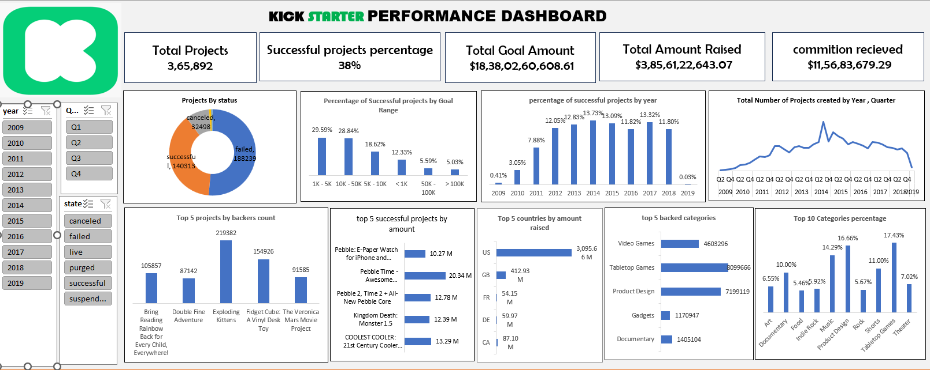
Excel Dashboard

Slide 7
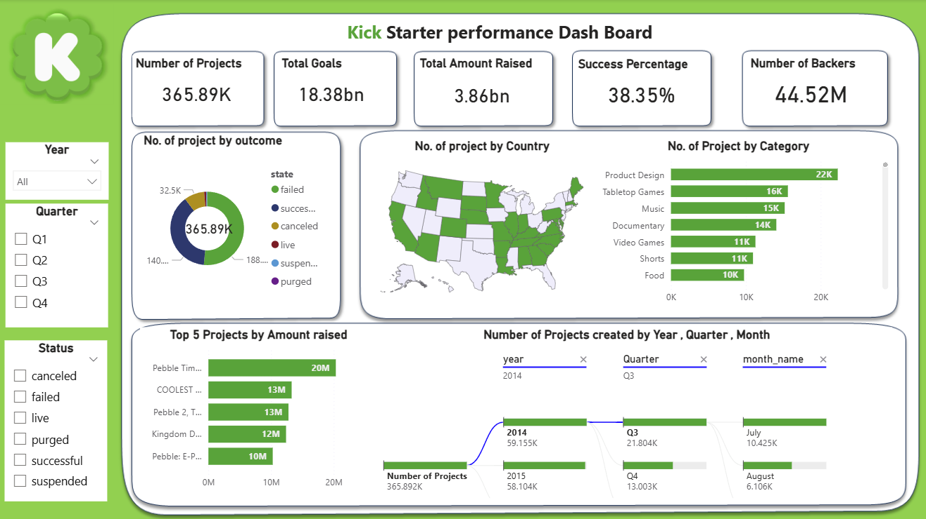
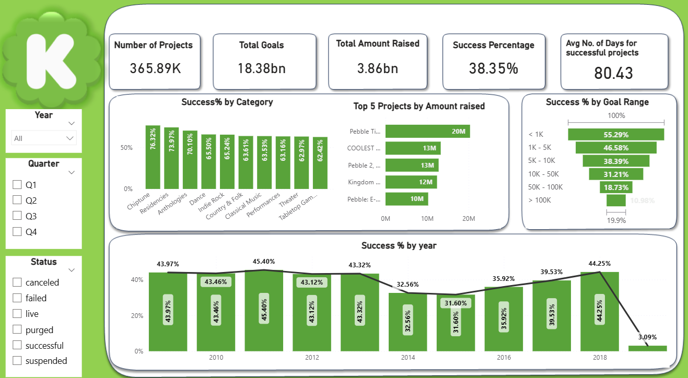
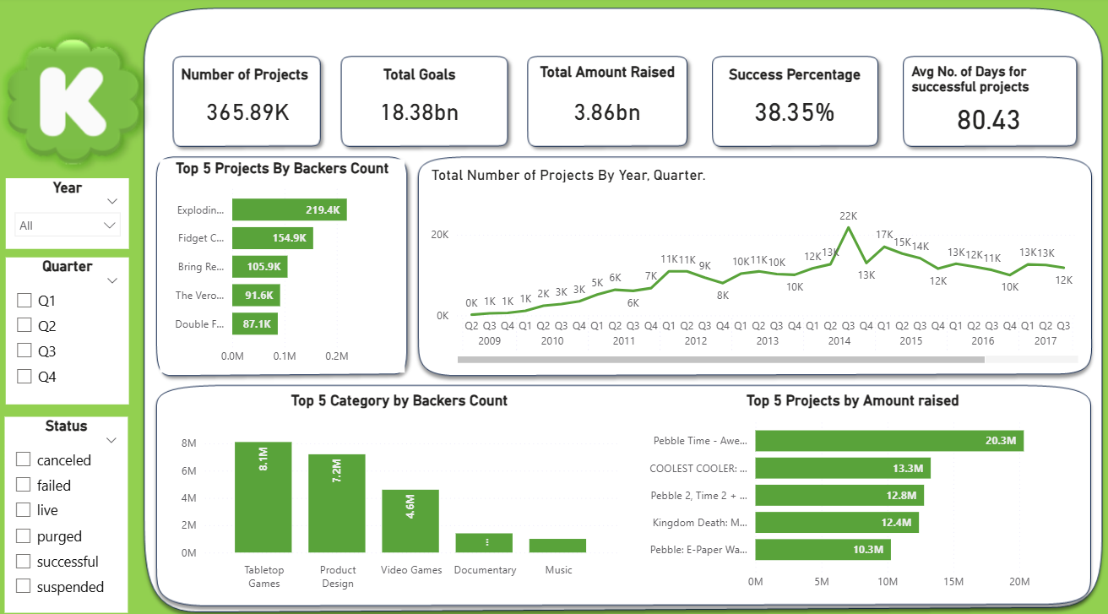
Power Bi Dashboards

Slide 8
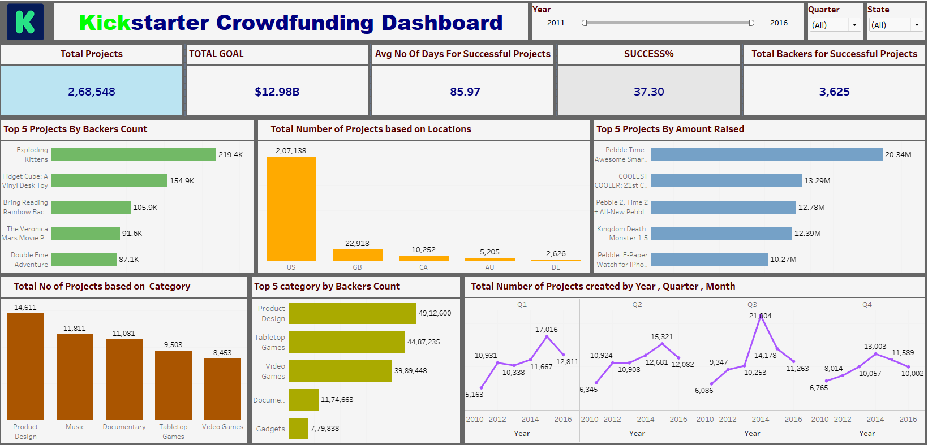
Tableau Dashboard

Slide 9
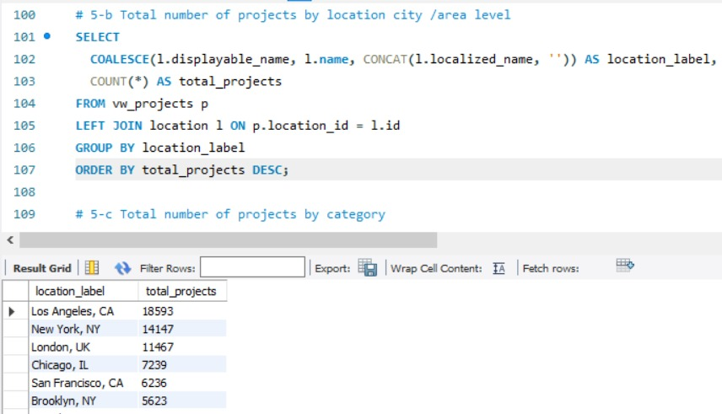
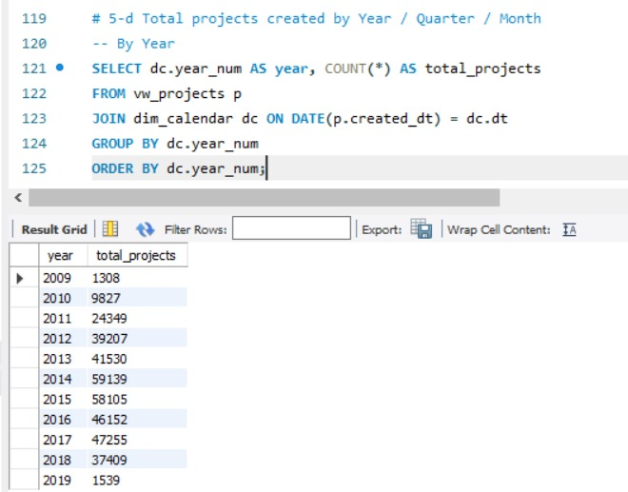
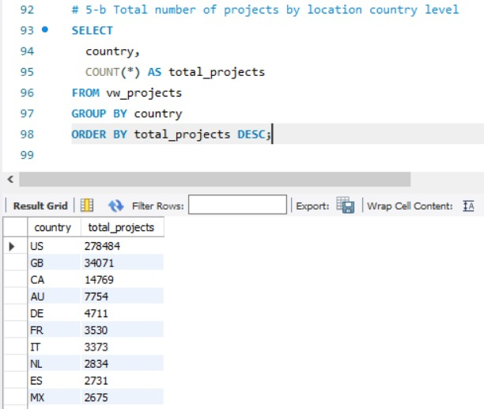
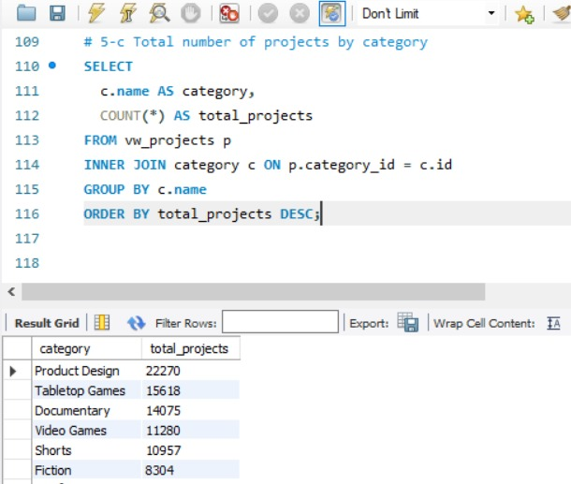
SQL

Slide 10
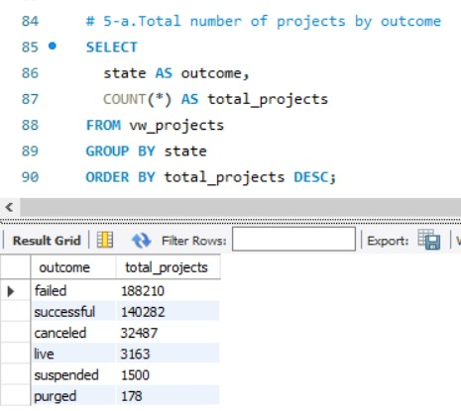
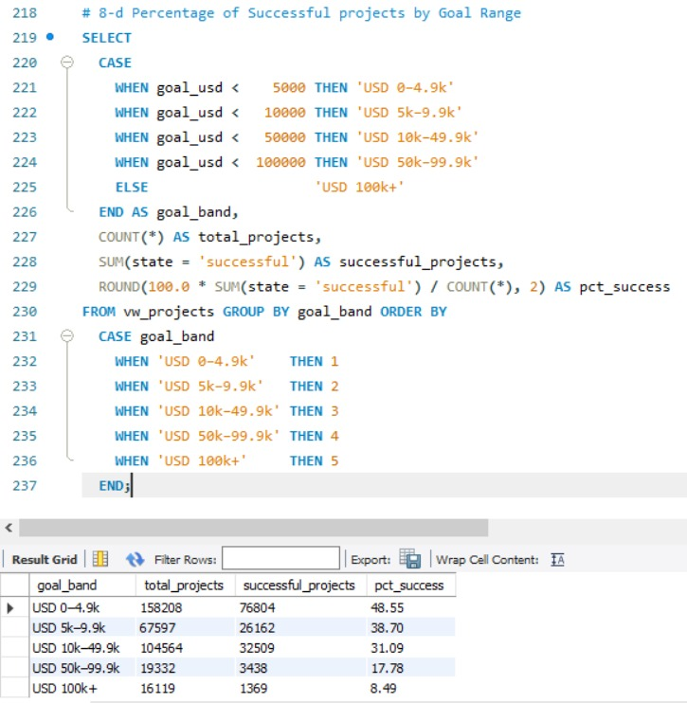
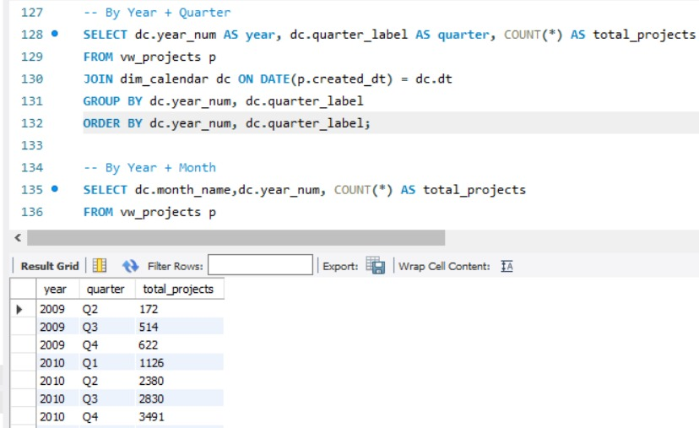
SQL

Slide 11
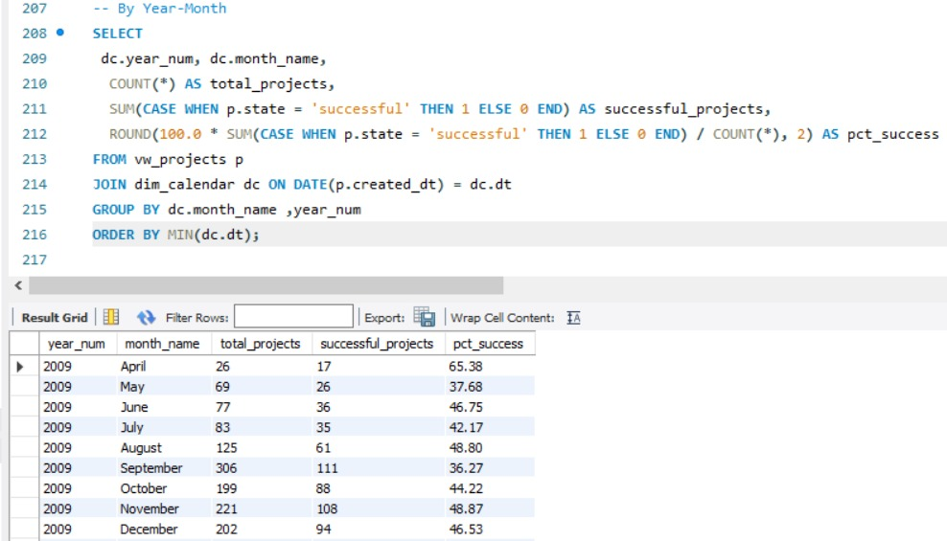
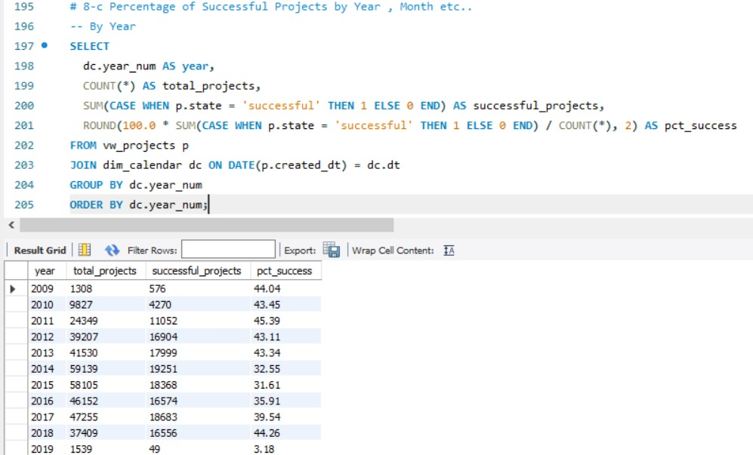
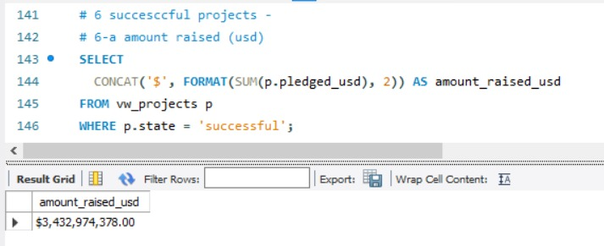
SQL

Slide 12
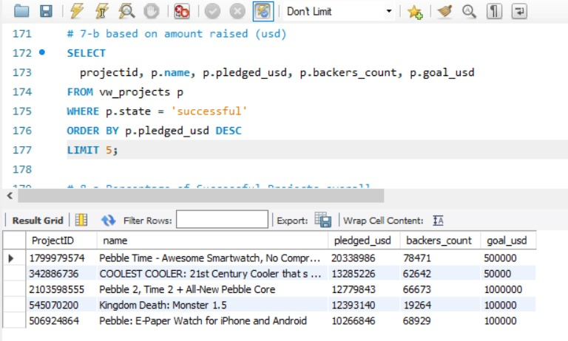
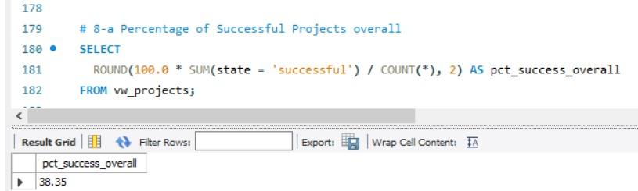
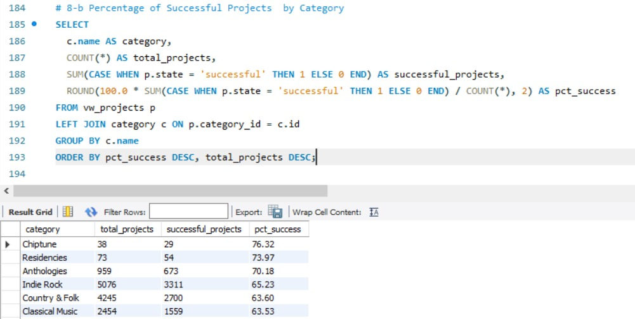
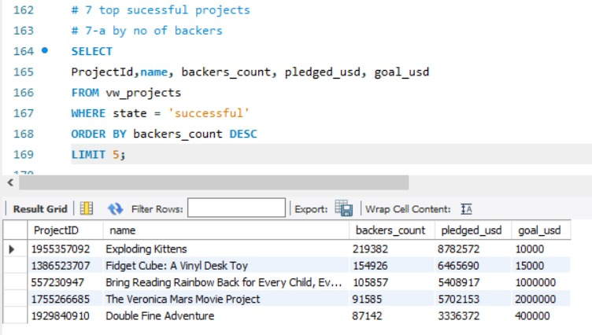
SQL

Slide 13

Challenges Faced And Solutions
Challenges Faced
Dates were stored in Epoch time, making them unreadable in dashboards.
Goal amounts were in different currencies.
Building a calendar table with year, quarter, month, and financial periods was a little difficult in excel and tableau.
Loading big tables into MySQL was difficult.
Some records had missing or inconsistent values.
Solutions Implemented
Used built-in functions (like FROM_UNIXTIME in SQL )/ Power Query date conversion), formulas in excel (= (A2/86400) + DATE(1970,1,1)) to transform them into readable date formats.
Applied a static USD conversion rate to standardize values for fair comparison across projects.
Created a custom calendar table with DAX in power-bi/SQL formulas in mysql to generate all required time columns.
The table data import method was very slow and was loading only a few rows, which affected the analysis. The LOCAL DATA INFILE method was not supported in the current MySQL version, so we used the DATA INFILE method by storing the CSV file in the path shown after running (SHOW VARIABLES LIKE 'secure_file_priv’;) and then importing from that location.
Applied cleaning steps in Power Query (handling nulls, standardizing text fields).

Slide 14
Challenges Faced
Challenges Faced And Solutions
Dates were stored in Epoch time, making them unreadable in dashboards.
Goal amounts were in different currencies.
Building a calendar table with year, quarter, month, and financial periods was a little difficult in excel and tableau.
Loading big tables into MySQL was difficult.
Some records had missing or inconsistent values.
Solutions Implemented
Used built-in functions (like FROM_UNIXTIME in SQL )/ Power Query date conversion), formulas in excel (= (A2/86400) + DATE(1970,1,1)) to transform them into readable date formats.
Applied a static USD conversion rate to standardize values for fair comparison across projects.
Created a custom calendar table with DAX in power-bi/SQL formulas in mysql to generate all required time columns.
The table data import method was very slow and was loading only a few rows, which affected the analysis. The LOCAL DATA INFILE method was not supported in the current MySQL version, so we used the DATA INFILE method by storing the CSV file in the path shown after running (SHOW VARIABLES LIKE 'secure_file_priv’;) and then importing from that location.
Applied cleaning steps in Power Query (handling nulls, standardizing text fields).

Slide 15
Key Take Aways
KPI Category | Metric | Value / Finding | Key Insight
🌍 Global Performance | Total Projects | 3,65,892 | Huge dataset over a decade
🌍 Global Performance | Success % | 38% | Less than 2/5 projects succeed
💰 Funding Gap | Goal vs. Raised | $18.38B vs. $3.86B | Only ~21% of funding goals met
💵 Revenue (Est.) | Commission | $193M | Earned via 5% fees
🚀 Success Driver | Best Goal Range | $1K–$5K (29.6%), $5K–$10K (18.8%) | Smaller goals = higher success
⚠️ High-Risk Goal | >$100K Success Rate | 5%–11% | Big goals rarely succeed
🎮 Category Volume | Top by Backers | Tabletop Games (8.1M), Product Design (7.2M) | Games & design lead engagement
🎭 Category Performance | Highest Success Rate | Choptune (76.3%), Dance (70.1%) | Niche creative categories thrive
📈 Time Trend | Peak Success Years | 2015 (13.8%), 2016 (13.8%) | Success peaked mid-2010s
👥 Project Volume | Total Backers | 44.52M | Strong community participation
⏳ Project Velocity | Avg Days for Success | 80.4 Days | Typical time to meet goals

Slide 16
Scope of Improvement
Reduce Funding Gap → Help creators set achievable targets by offering AI-driven goal recommendations.
Boost Success Rate → Promote smaller campaigns (<$10K) with higher visibility and featured spots.
Improve Backer Confidence → Strengthen project verification & progress tracking to reduce risk perception.
Revive Growth → Introduce new engagement features (live Q&A, community voting, milestone rewards) to bring back peak momentum from mid-2010s.
Support Large Campaigns → Provide mentorship, phased funding options, and investor partnerships for projects >$100K
Conclusion
Kickstarter demonstrates massive global reach with over 3.6 lakh projects and 44M+ backers, but success remains challenging (38% rate).
Projects with smaller, realistic goals (<$10K) see the highest success, while large ambitious goals (>100K) are mostly unsuccessful. Categories like Games, Design, and Creative Arts drive engagement, but funding ambitions often outpace actual pledges.
The platform thrives on community-driven, niche, and modest campaigns.

Slide 17
Thank you

